Slide 1
Complexity-based Economic and Production Analysis: Overview and Country Report
With analysis for Brazil, China, Egypt, France, Germany, Japan, Malaysia, Mexico, Morocco, South Africa, South Korea, Spain, Turkey, UAE and USA
Heyang Huang, Soulaymane Kachani, Lun Li, Jiayu Zhao
Columbia University

Slide 2
Contents
1. Overview
2. Economic Complexity Framework
3. Production Analysis
4. Product Space Design
5. Macro-level Predictions
6. Reference
7. Appendix

Slide 3
1. Overview
With an increasing volume of international trade, countries are more specialized than ever in production and have diversified into distinct production patterns
Based on global export data available to us, in this report we examine countries’ growth paths and product spaces on a complexity level, during the period from 2009 to 2014
The rest of the report is organized as follows:
Section 2
Countries’ economic complexity is quantified the same way as defined by Hausmann and Hidalgo (2009)
Section 3
Products are grouped into industry families and the growth paths adopted by countries during the period are closely examined
Section 4
Analyses are conducted on countries’ sequential development strategy, sensitivity to industry upheaval and the contingency plan
Section 5
Macro-level results are used to assess countries’ structural optimality
Section 7
Country-specific results are available for further reviews

Slide 4
2. Economic Complexity Framework
2.1 Economic Complexity
2.2 Production Matrix
2.3 Diversity and Ubiquity
2.4 Economic & Product Complexity Index
2.5 Proximity and Distance
2.6 Opportunity Gain

Slide 5
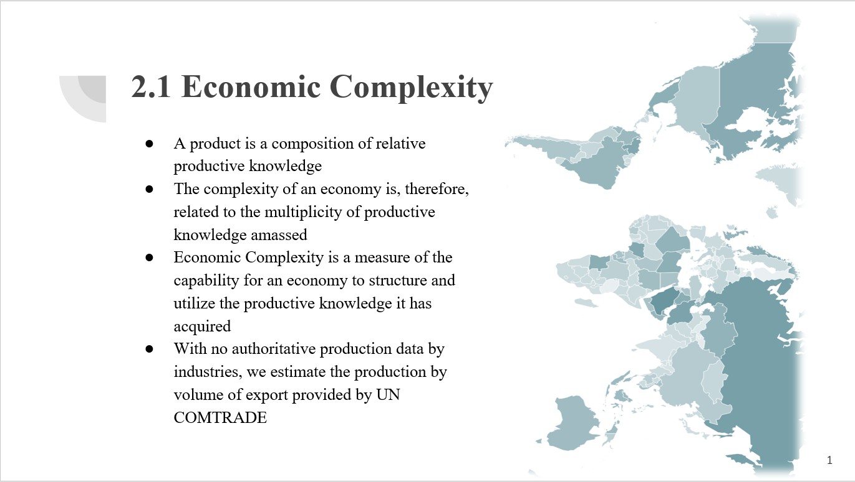

Slide 6
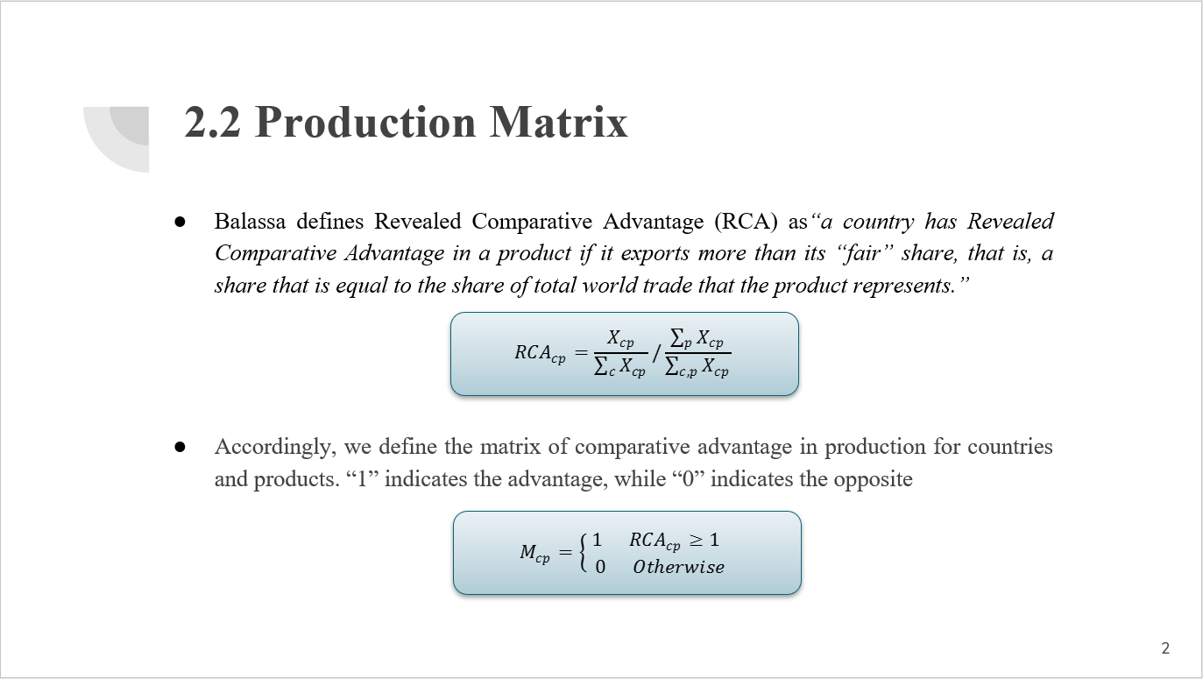

Slide 7
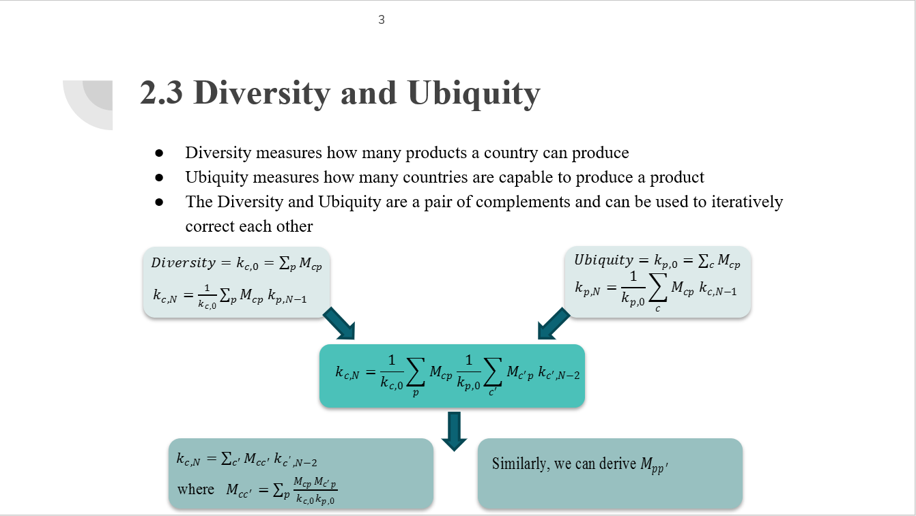

Slide 8
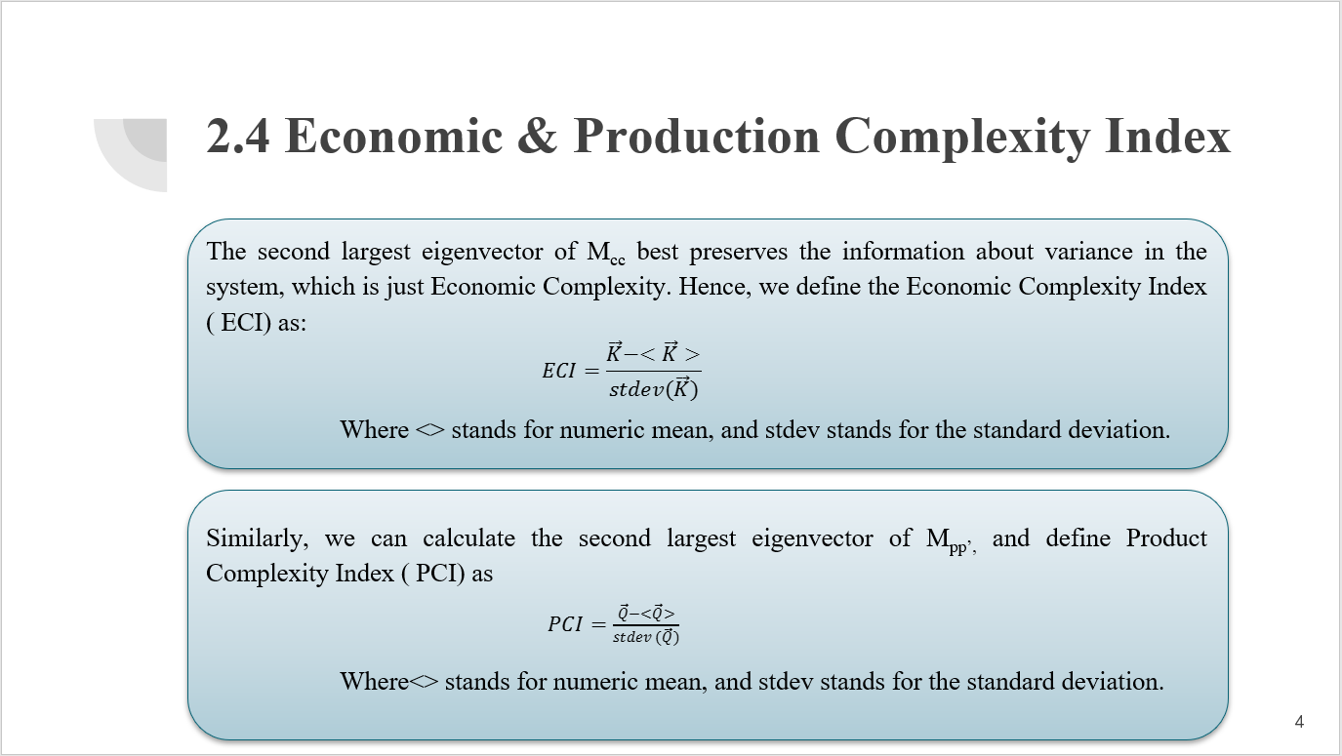

Slide 9
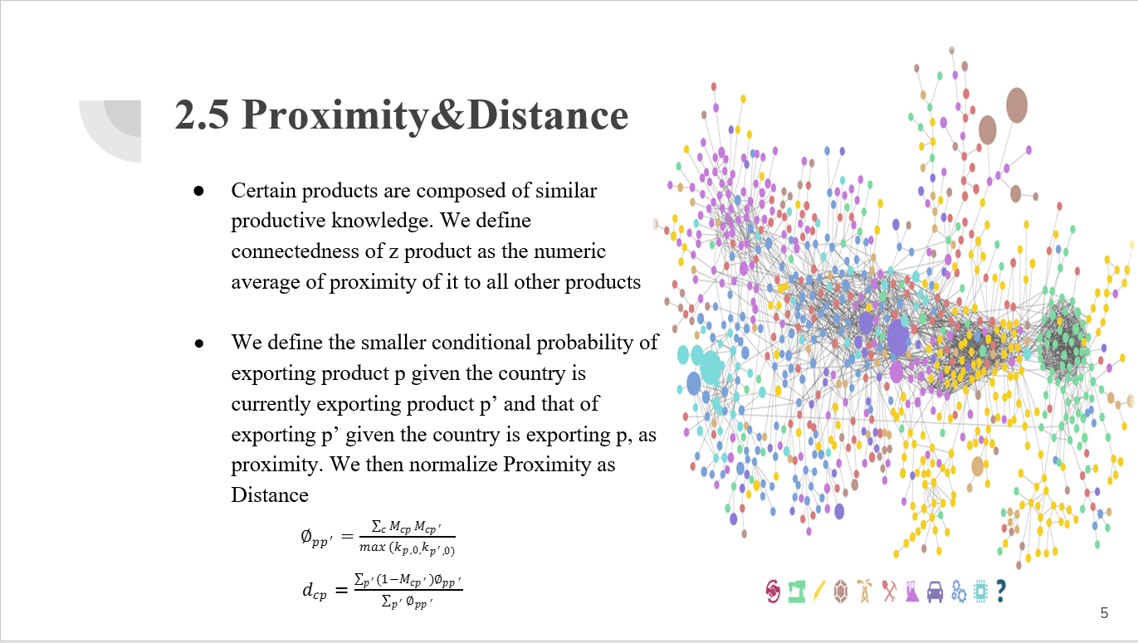

Slide 10
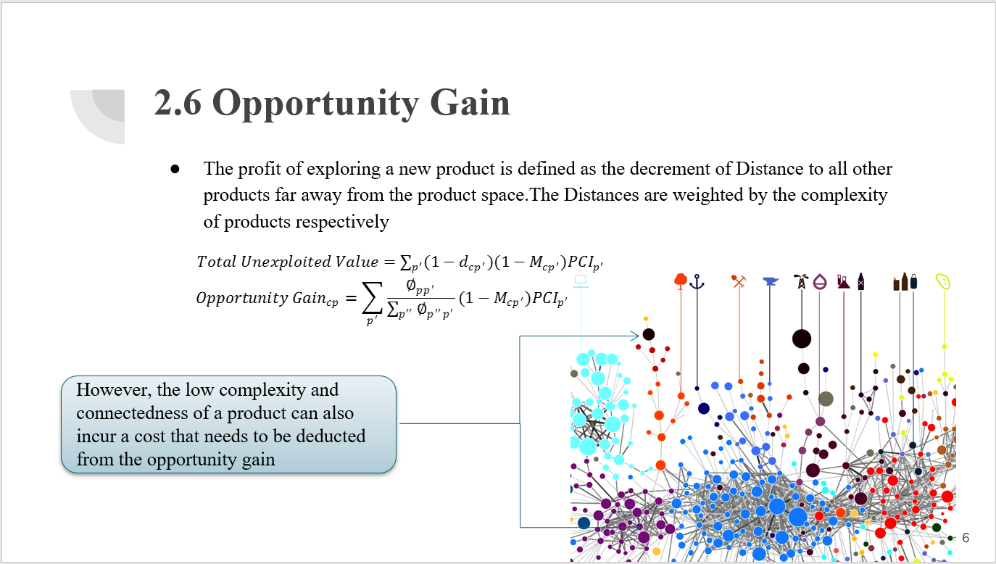

Slide 11
3. Production Analysis
3.1 Product Categorization
3.2 Actual Development Index
3.3 Regional and Global Comparison

Slide 12
3.1 Product Categorization
Product groups in UN Comtrade are labelled from 010000-999999, with the first two-digits representing a category to which the product belongs
From the 99 categories as extracted from the label, we further group the products into 18 major and widely-accepted industry categories
High-tech is an aggregated industry that indicates the most complicated products from the most technologically-advanced industries, as measured by PCI, and in regression it explains over 67.6% of countries’ GDP
Animal and By-product Raw Manufacturing Transportation Vegetable, Fruit and Plant Wood Product Weapon Food and Preparation Clothing and Accessory Daily Instrument Mineral and Stone Textile Precious Stone Chemical Metal Service Chemical Manufacturing Machinery High-tech

Slide 13
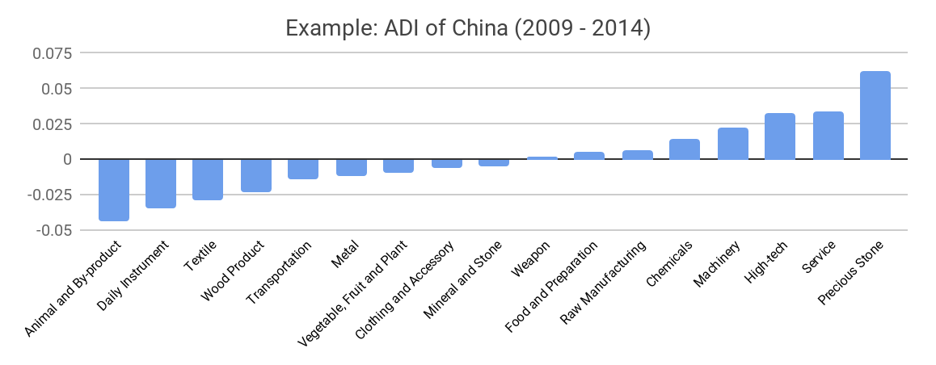
3.2 Actual Development Index
Based on this concept of distance between countries and product families, we defining the net distance change between two periods as the Actual Developmental Index (ADI)
ADI measures by how much a country has moved in the direction of a certain product family in its product space during the period, and is a relative concept

Slide 14
3.3 Regional and Global Comparison
It can be observed that leading economies, such as U.S. and Germany, in general focus on products with higher level of complexity
Reasonably, emerging economies such as China, South Korea, Singapore and India have devoted the majority of their efforts into intermediate industry groups
Chemical Manufacturing
Machinery
Chemicals
Precious Stone
USA
China
Service
Wood Product
Transportation
Daily Instrument
Germany
India
High-tech
Chemicals

Slide 15
4. Production Space Design
4.1 Suggested Development Vector
4.2 Sequential Development Strategy
4.3 Sensitivity Analysis
4.4 Contingency Plan

Slide 16
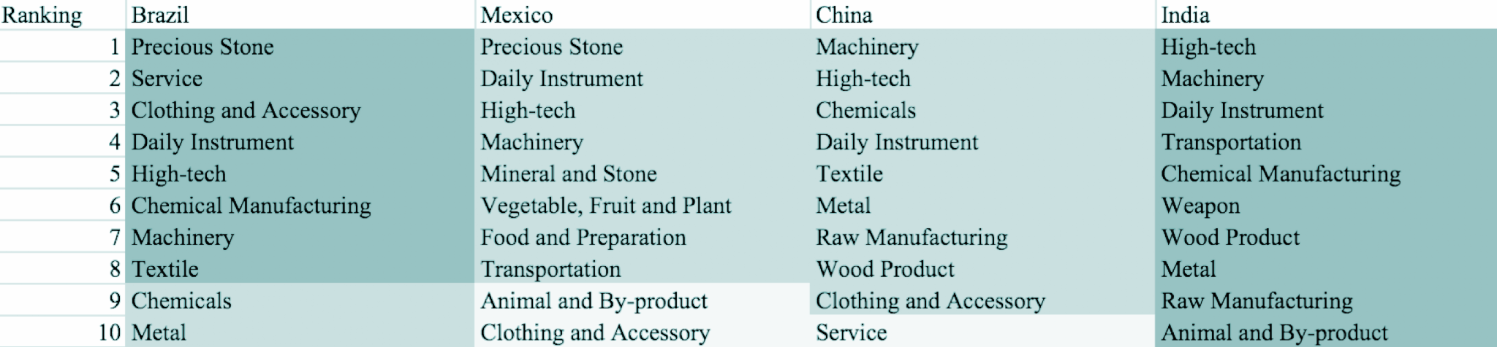
4.1 Suggested Development Vector
We define the ranking of opportunity gain of a country as the Suggested Development Vector (SDV) of the country
Leading economies are typically well-shaped and barely have any industries with positive opportunity gain, while emerging economies need a sequential strategy that allows for prioritization of certain industries

Slide 17
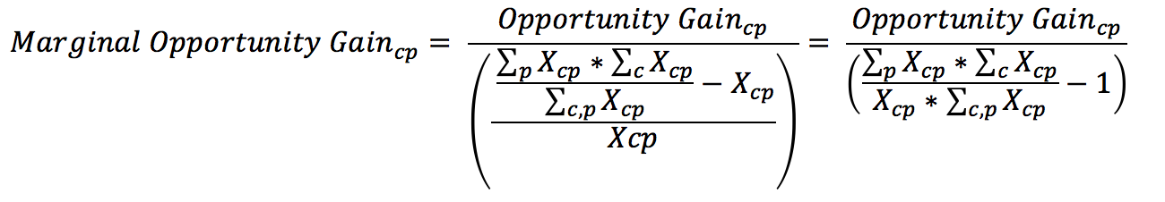
4.2 Sequential Development Strategy
As the difficulty of bumping up MCP varies across industries, we need to capture this variation of difficulty by defining the concept of marginal opportunity gains as follows
In each iteration, we order all 18 industries based on their current marginal opportunity gain, and prioritize the industry with the highest marginal opportunity gain
We then increase the prioritized industry’s export to an extent that the MCP firmly bumps up to 1, and re-perform calculations to prioritize the next industry

Slide 18
4.2 Sequential Development Strategy
Calculated using the sequential strategy algorithm, the example of Morocco shows how the prioritization of a developing country evolves from basic products to intermediate-level products

Slide 19
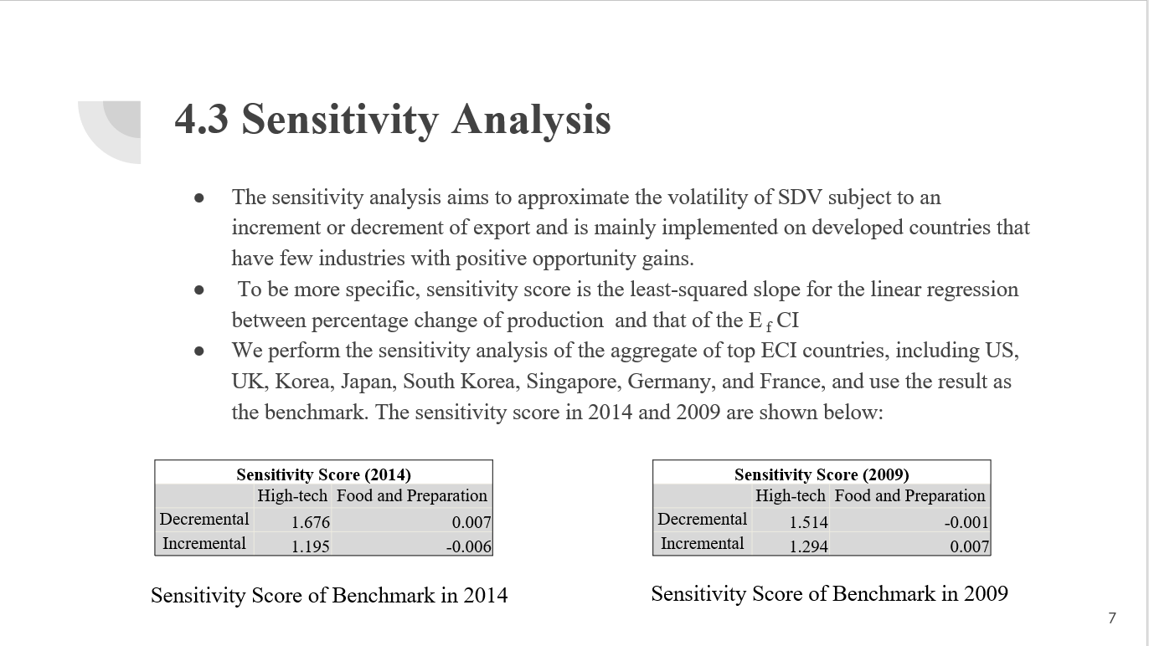

Slide 20
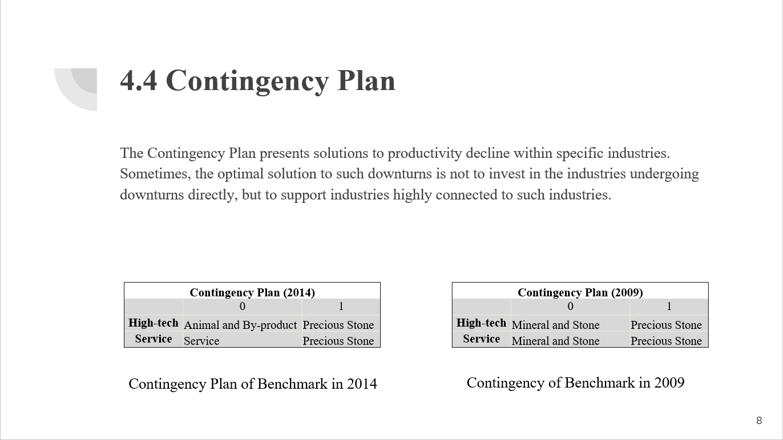

Slide 21
5. Macro-level Predictions
5.1 Structural Optimality Index (SOI)
5.2 SOI Examples and Implications

Slide 22
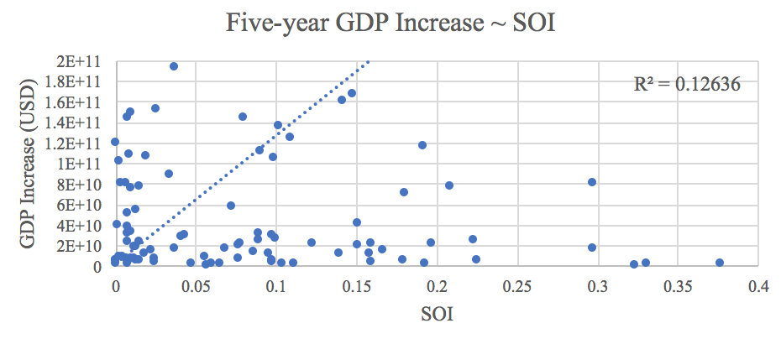
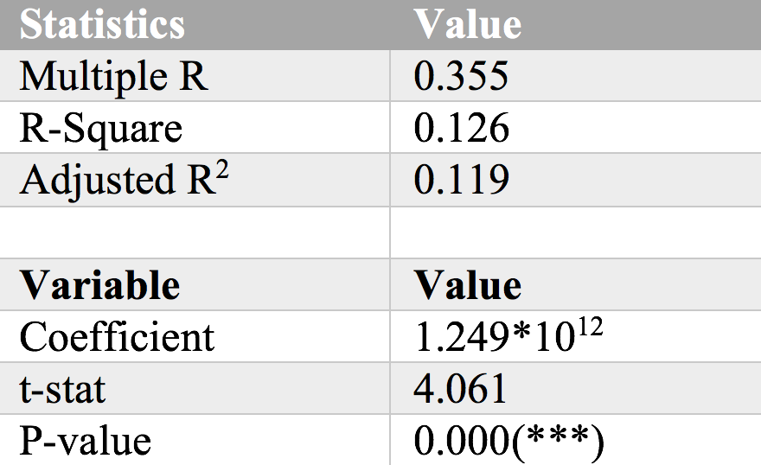
5.1 Structural Optimality Index (SOI)
Structural Optimality Index (SOI) is defined as the adjusted R-Square of export increase in industries ~ opportunity gains of industries
SOI provides a quantified measure of how the development path adopted by a country fitted with/differed from calculations on a complexity level (i.e., the opportunity gains)
We further observe a significant correlation between SOI and five-year GDP increase of countries, indicating that structural optimality does impact economic outcomes

Slide 23
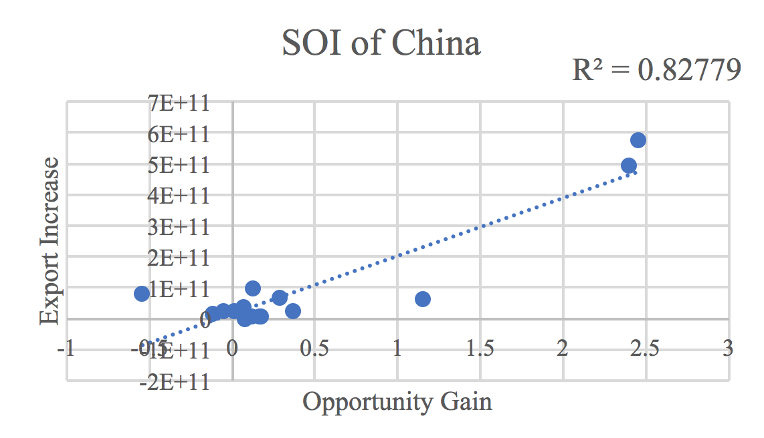
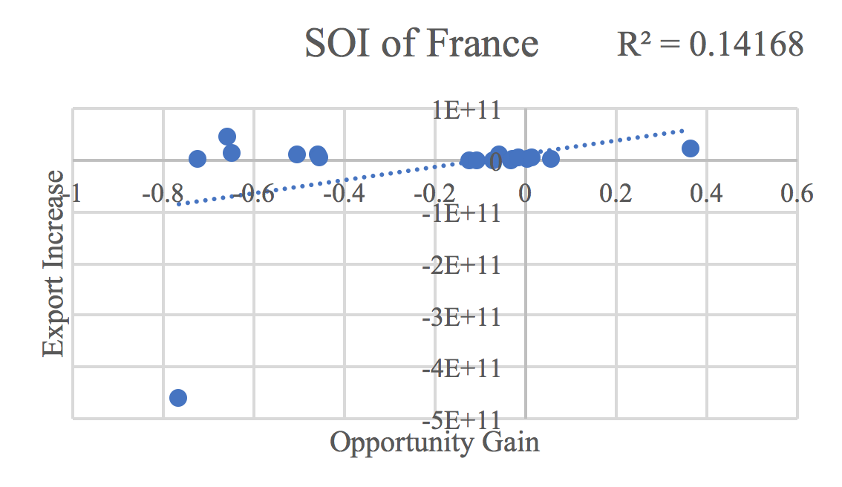
5.2 SOI Examples and Implications
Taking China and France for comparison, China ranks the 1st place among all countries in terms of SOI (82.8%), and has the highest economic growth rate from 2009 to 2014
In contrast, developed economies such as France, where there is a moderate SOI of around 14.2% and a corresponding annual growth rate of 1.1%
Intermediate-term economic progress can be at least partially explained by the optimality of development strategy that countries choose to adopt

Slide 24
6. Reference
Hausmann, R., Hidalgo, C., Bustos, S., Coscia, M., Chung, S., Jimenez, J., Simoes, A. and Yıldırım, M. (2007). The Atlas of Economic Complexity. [online] Atlas.cid.harvard.edu. Available at: http://atlas.cid.harvard.edu/.
Comtrade.un.org. (n.d.). Download trade data | UN Comtrade: International Trade Statistics. [online] Available at: https://comtrade.un.org/data/.

Slide 25
7. Appendix
In this section we outline the most important calculations & analysis results for a selected group of countries, including Brazil, China, Egypt, France, Germany, Japan, Malaysia, Mexico, Morocco, South Africa, South Korea, Spain, Turkey, UAE and USA
For each country, we highlight its GDP & ECI trend, Actual Development Index (ADI), Suggested Development Vector (SDV), sensitivity score & plan, contingency table and Structural Optimality Index (SOI) during the period
Notes:
Each country has several pages: GDP and ECI trend graph, ADI chart, SDV, sensitivity score, sensitivity plan, contingency table, SOI
GDP/ECI trend graph: 2.2, figure 3
ADI Chart: 3.2, table 2
SDV: 4.1, table 5 (opportunity gain csv file in “resource”) (all nation within one table)
Sensitivity Score: 4.3, table 17,18
Sensitivity Plan: 4.3, table 19 (need excel file from Heyang)
Contingency Table: 4.3, table 23, 24
SOI: 5.2, Figure 7 (R^2 required) (change the country name in the code, line 211)

Slide 26
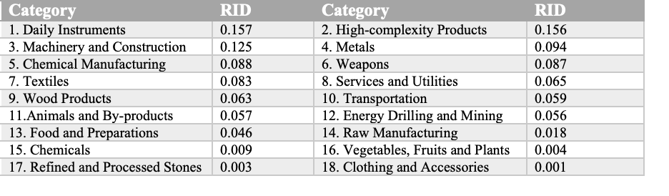
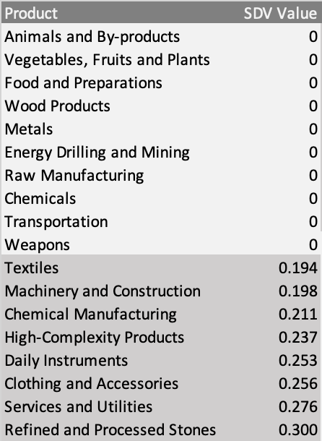
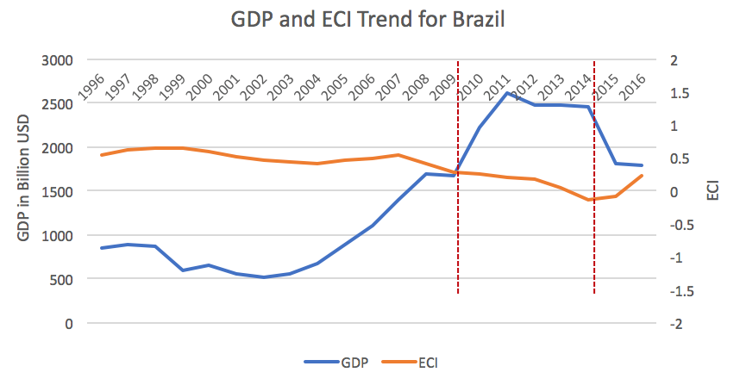
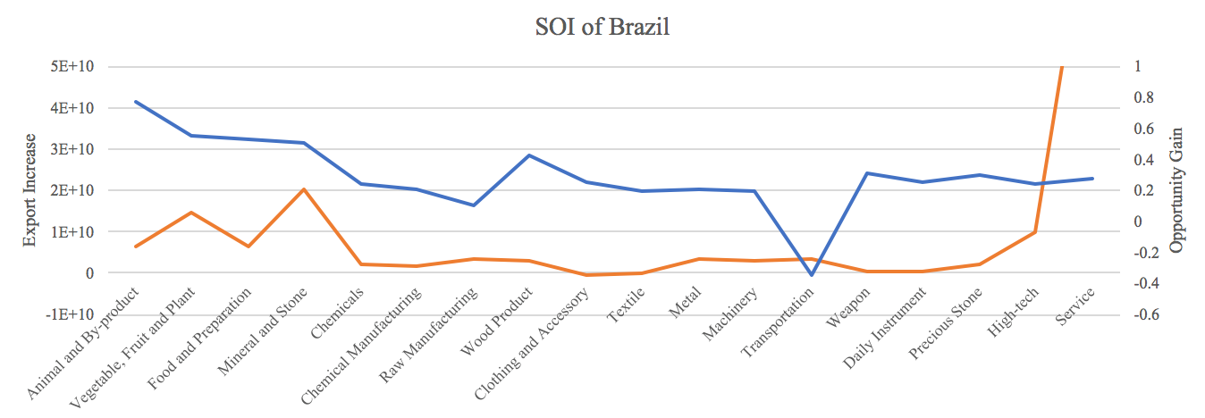
7.1 Brazil
Table 1: Realized Industry Development (RID)
Table 2: Suggested Development Vector (SDV)
SOI=0.8%

Slide 27
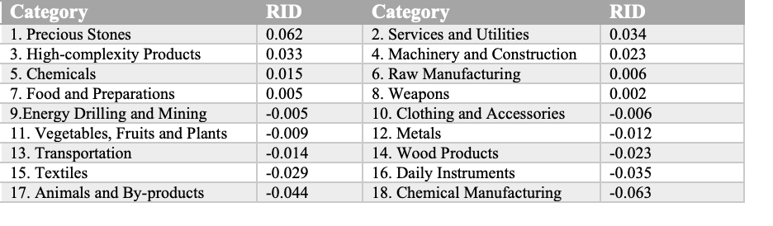
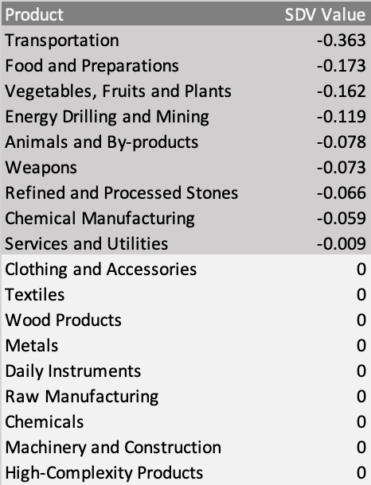
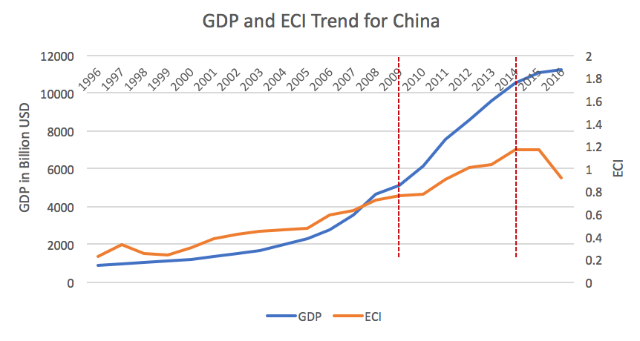
7.2 China
Table 1: Realized Industry Development (RID)
Table 2: Suggested Development Vector (SDV)

Slide 28
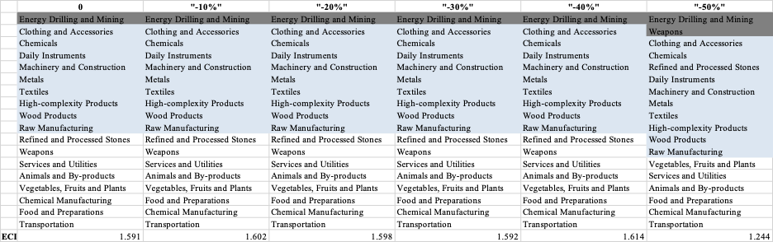
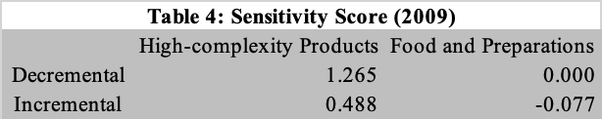
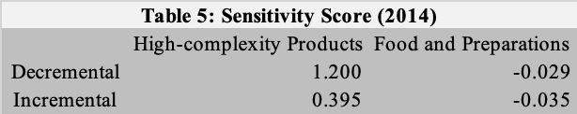
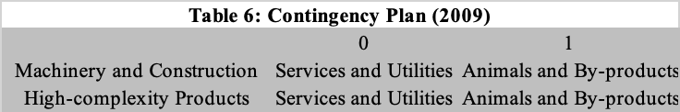
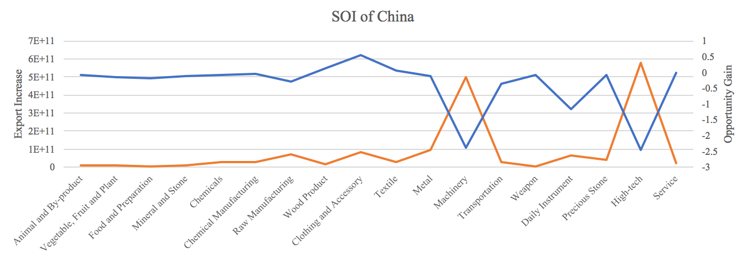
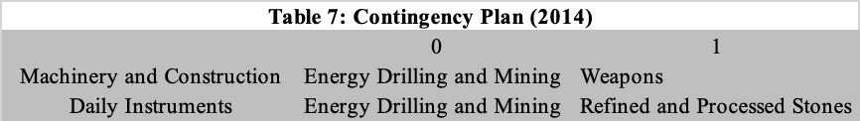
7.2 China
Table 3: High-tech Sensitivity Plan Table (2014)
SOI=82.8%

Slide 29
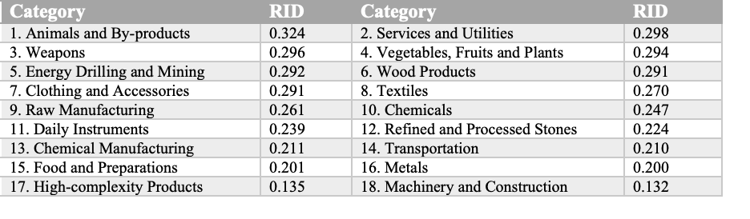
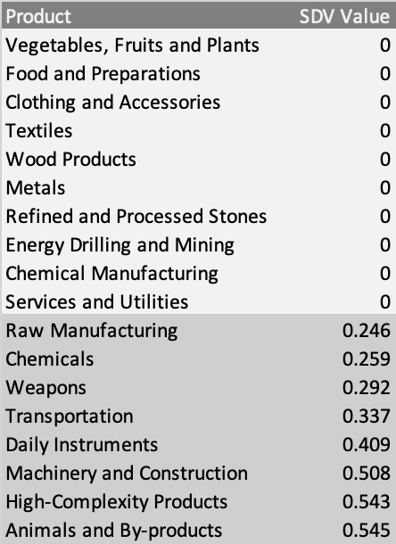
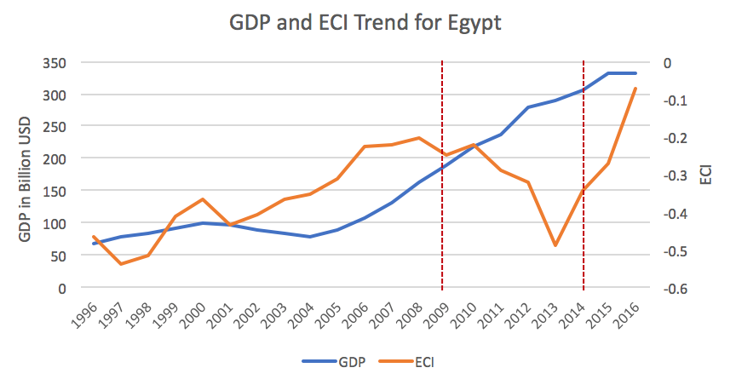
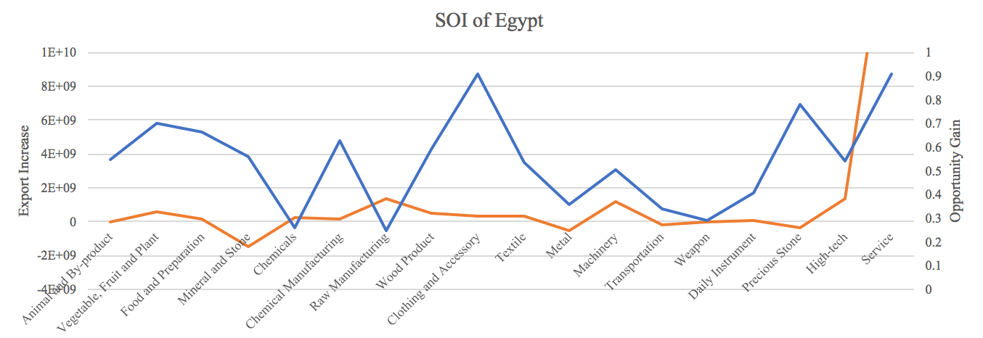
7.3 Egypt
Table 1: Realized Industry Development (RID)
Table 2: Suggested Development Vector (SDV)
SOI=19.2%

Slide 30
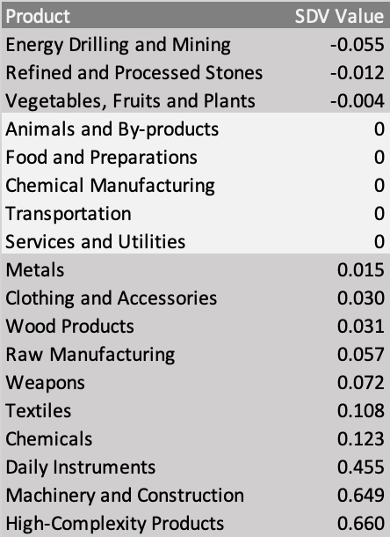
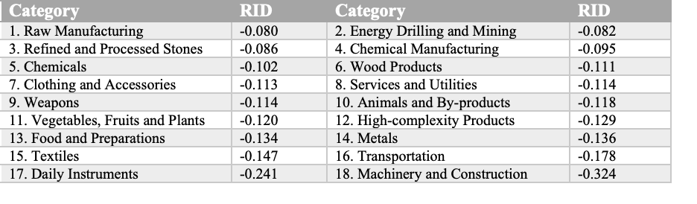
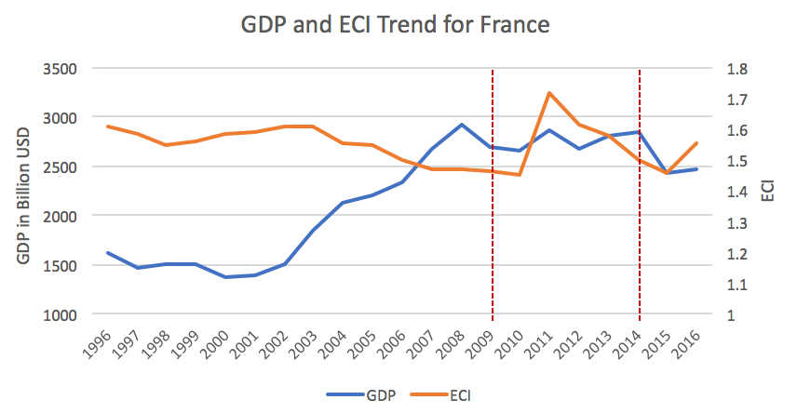
7.4 France
Table 1: Realized Industry Development (RID)
Table 2: Suggested Development Vector (SDV)

Slide 31
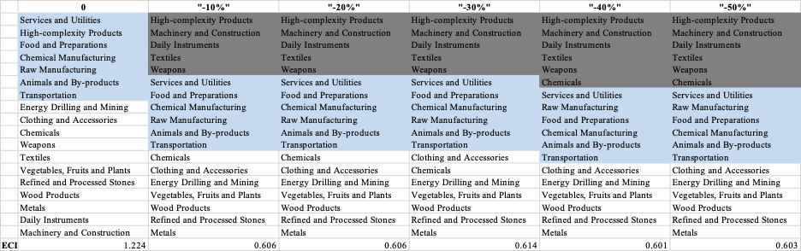
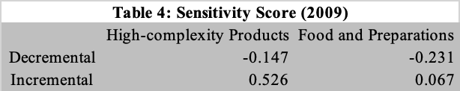
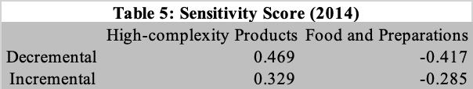
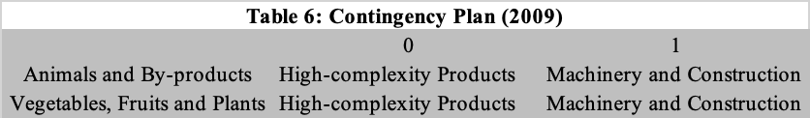
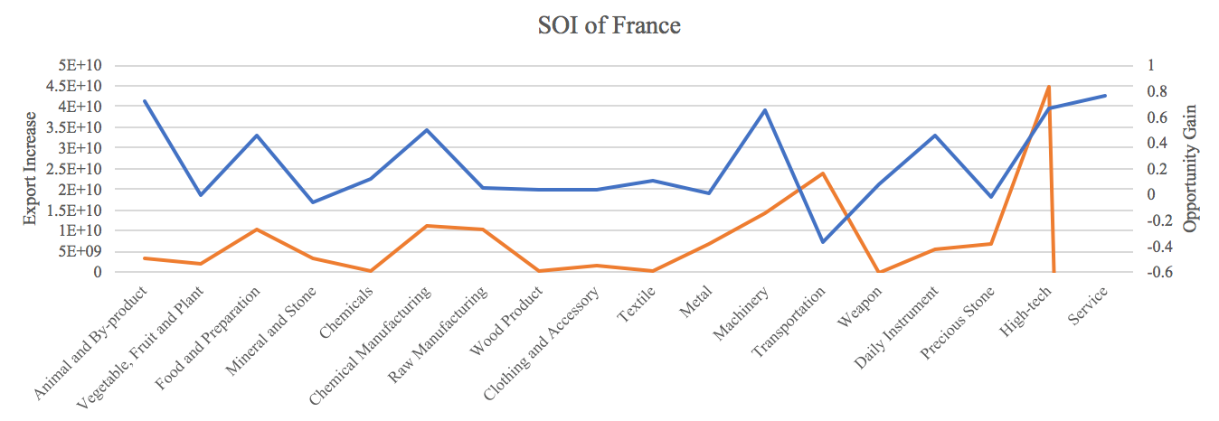
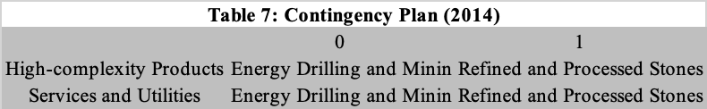
7.4 France
Table 3: High-tech Sensitivity Plan Table (2014)
SOI=14.2%

Slide 32
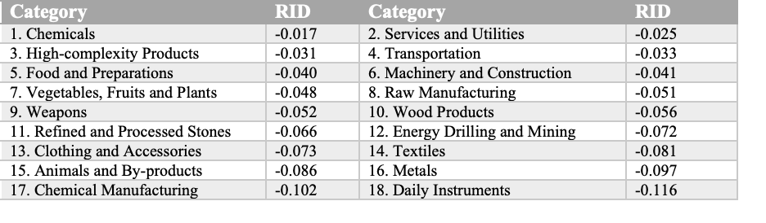
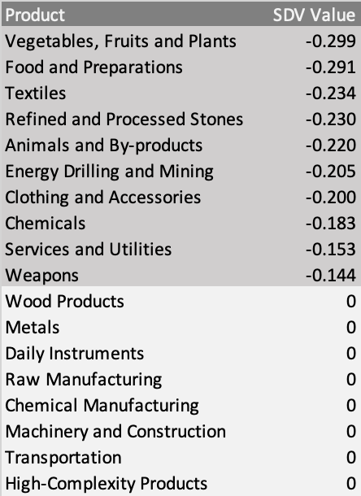
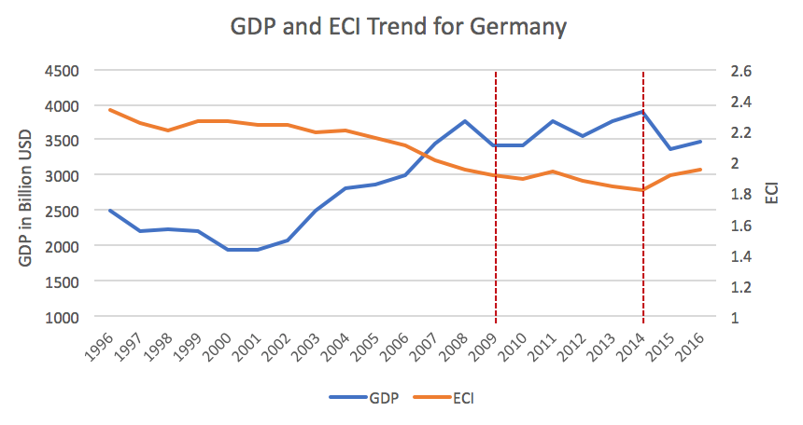
7.5 Germany
Table 1: Realized Industry Development (RID)
Table 2: Suggested Development Vector (SDV)

Slide 33
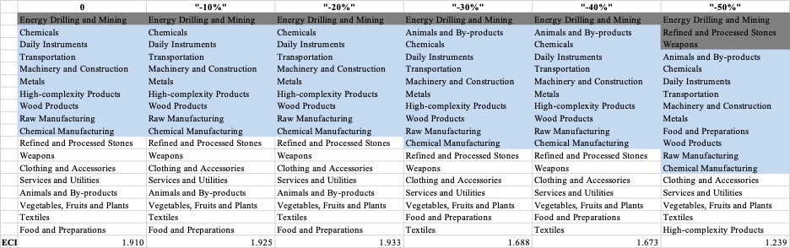
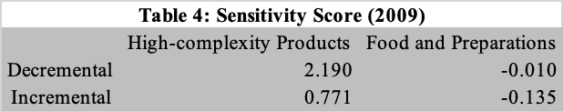
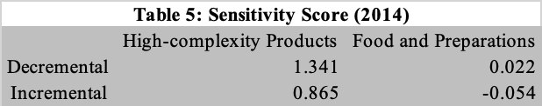
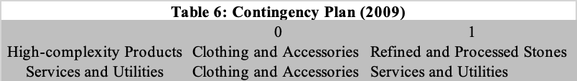
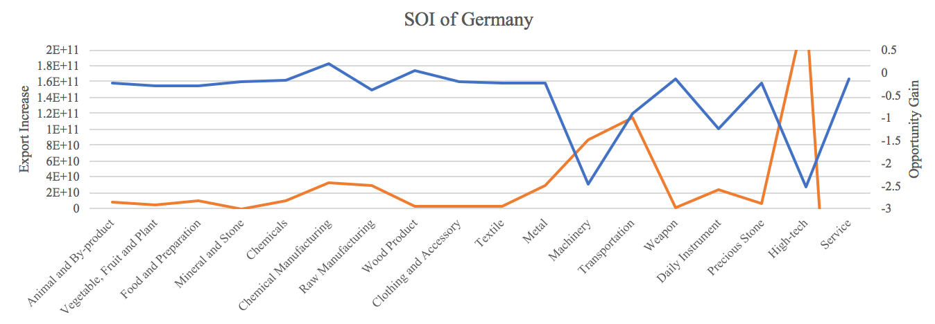
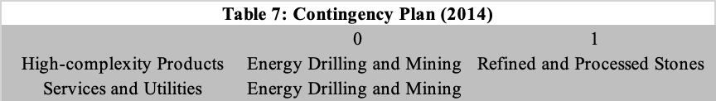
7.5 Germany
Table 3: High-tech Sensitivity Plan Table (2014)
SOI=19.4%

Slide 34



7.6 Japan
Table 1: Realized Industry Development (RID)
Table 2: Suggested Development Vector (SDV)

Slide 35




7.6 Japan
Table 3: High-tech Sensitivity Plan Table (2014)
SOI=58.3%

Slide 36



7.7 Malaysia
Table 1: Realized Industry Development (RID)
Table 2: Suggested Development Vector (SDV)

Slide 37





7.7 Malaysia
Table 3: High-tech Sensitivity Plan Table (2014)
SOI=10.2%

Slide 38



7.8 Mexico
Table 1: Realized Industry Development (RID)
Table 2: Suggested Development Vector (SDV)

Slide 39






7.8 Mexico
Table 3: High-tech Sensitivity Plan Table (2014)
SOI=68.3%

Slide 40




7.9 Morocco
Table 1: Realized Industry Development (RID)
Table 2: Suggested Development Vector (SDV)
SOI=29.7%

Slide 41




7.10 South Africa
Table 1: Realized Industry Development (RID)
Table 2: Suggested Development Vector (SDV)
SOI=1.3%

Slide 42



7.11 South Korea
Table 1: Realized Industry Development (RID)
Table 2: Suggested Development Vector (SDV)

Slide 43




7.11 South Korea
Table 3: High-tech Sensitivity Plan Table (2014)
SOI=48.3%

Slide 44




7.12 Spain
Table 1: Realized Industry Development (RID)
Table 2: Suggested Development Vector (SDV)
SOI=14.3%

Slide 45




7.13 Turkey
Table 1: Realized Industry Development (RID)
Table 2: Suggested Development Vector (SDV)
SOI=13.8%

Slide 46




7.14 United Arab Emirates
Table 1: Realized Industry Development (RID)
Table 2: Suggested Development Vector (SDV)
SOI=1.0%

Slide 47



7.15 USA
Table 1: Realized Industry Development (RID)
Table 2: Suggested Development Vector (SDV)

Slide 48






7.15 USA
Table 3: High-tech Sensitivity Plan Table (2014)
SOI=28.7%

